Slide 1
Soar Semantic Memory
Yongjia Wang
University of Michigan
Notes:
So far, Soar has been working fairly well without a semantic memory.
In this presentation, I’ll talk about critical issues related to semantic memory/learning.
And propose an architectural design of semantic memory for Soar, and go into more details.

Slide 2
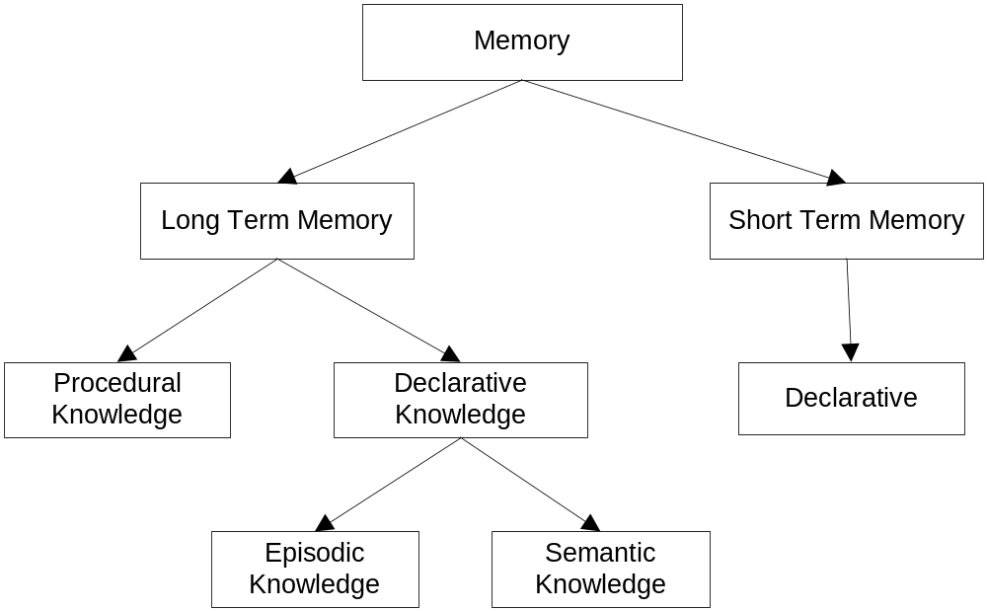
Memory and Knowledge Representation
Notes:
This diagram is the taxonomy hierarchy of memory.
Memory system consists of long-term and short-term memories. This view is mainly based on functional considerations, and there are neurobological and psychological justifications as well.
Short-term memory (working memory) hold the input from the environment which represents the current situation, based on which knowledge is applied to generate behavior.
In terms of representation, there are declarative representation and procedural representation. Working memory is declaratively represented which be tested by procedurally represented production rules, they work together to make the system run.
SOAR working memory and ACT-R buffers are examples of short-term memory, WMEs and chunks are declarative representation. Both SOAR and ACT-R use production rules, which is procedural representation.
The short-term declarative representation in WM may be saved in long-term memory as knowledge to guide future behavior.
Declarative knowledge can be further divided into episodic knowledge and semantic knowledge.

Slide 3
Soar Semantic Memory
Current status of Soar
  Long-term procedural memory
  Only short-term declarative storage
Data learning problem (Young, R.M. 2004)
Integrate architectural declarative memories with Soar
  Episodic memory (events)
  Semantic memory (facts)
Notes:
Short-term, declarative representation and rules are required for the system to run.
SOAR doesn’t save the long-term storage for WMEs, instead, SOAR proceduralizes the retrieval of the necessary declarative knowledge, and save them in the form of production rules. The single procedural knowledge representation works quite well to encode initial knowledge, declarative or procedurally. But it has problem to learn new declarative knowledge. Chunking is not the way to do that.
Data learning is a major discovery in Soar, and is believed to demonstrate some limitations of procedural representation and chunking.
The general idea is that regular chunking cannot learn desired associational rules (proceduralized declarative knowledge retrieval) , and must use some tricks to do that, which is rather cumbersome.
To have long-term declarative memory will solve the problem straight-forwardly.
For more detail about data learning problem itself, refer to the paper, which also compared SOAR and ACT-R
Currently we are extending SOAR architecture by integrating architectural declarative memories.
To have some general idea,
Soar semantic memory would be equivalent to ACT-R declarative memory.
Soar episodic memory will touch on some different aspects beyond that.

Slide 4
ACT-R
The ‘chunk’ declarative data structure
Buffers holding single chunk
Long term production memory
Long term declarative memory
visualization
goal
declarative memory
#3
perception
#45
#45
red #3 ‘x’ #9
Notes:
We’ll first briefly go through another cognitive architecture ACT-R to see how ACT-R works.
I believe this will help understand the related issues to be discussed later.
ACT-R ‘chunk’ is the declarative representation, which has an array of slot-value pairs.
The value of a slot could be the chunk-name of some other chunk, therefore form a semantic network by the connections.
There are specialized buffers each holding a single chunk. Buffers serve for the same functionalities as SOAR working memory.
Production rules can test buffers and fire to have actions on buffers.
There are long-term declarative memory to save the chunks when they are cleared from the buffer.
SOAR semantic memory just corresponds to the ACT-R declarative memory.

Slide 5
Relevant Soar - ACT-R Differences
Soar
  Single generic Working Memory
  WME structures represent individual attributes
  Activations associated with individual attributes
  Complex WM structures, parallel/serial rule firing
ACT-R
  Specialized buffers
  Chunk is the atomic retrieval unit
  Activations associated with chunks
  Each buffer holds single chunk, serial rule firing
Notes:
Everything seems so simple so far, but there are these related differences between ACT-R and SOAR that will also make differences in semantic memory.
These are long standing architectural differences that are expected to keep existing for ‘quite a while’.
In general,
ACT-R makes more theoretic commitments about working memory. Soar makes minimal commitments.
The unrestricted form of WM structure allows Soar to take advantage parallel rule firing. Operator is the mechanism to enforce required serializations.
One advantage of individual attribute associated activation is to provide a domain-independent way to determine weights of features, which has already been tested in Episodic memory implementation.

Slide 6
Proposed Changes for Soar (9)
Long-term declarative storage
  Long-term identifiers
  WMEs related by the same identifier equivalent to an ACT-R chunk, long-term identifier equivalent to chunk name
Uni-valued attributes
  Soar has been allowing for multi-valued attributes
    Needed to support old values of attributes
  ACT-R uses uni-value attribute scheme
Notes:
In addition to adding semantic memory,
here are the high-lighted critical changes to be made for SOAR 9, that may affect the rest of the system outside semantic memory.
In the following slides, declarative chunk or chunk will refer to the WMEs…
Any subset of those WMEs could be view as a chunk, and there is no explicit definition for a chunk, as SOAR WMEs work rather independently. The only relation is via the same identifier to make them into a ‘chunk’. Long-term identifier will play an important role.
About uni-valued attributes. Soar has been allowing for multi-valued attributes (represented by separate WMEs), to support old values of attributes.
When semantic learning and memory retrieval can be performed, coexisting of new/old values may confuse the system in some situations.

Slide 7
Basic Semantic Memory Functionalities
Encoding
  What to save?
  When to add new declarative chunk?
  How to update knowledge?
Retrieval
  How the cue is placed and matched?
  What are the different types of retrieval?
Storage
  What are the storage structures?
  How are they maintained?
Notes:
Here are the decomposed functionalities of semantic memory. We’ll look at each of those questions in more detail.
Those questions, in nature, are heavily interrelated and constrained with each other.
Some questions are relatively easier to commit, some are rather open issues.

Slide 8
Soar 9 Semantic Memory Functionalities
AutoCommit
state
Feature Match
Working Memory
Semantic Memory
B
A
A
Retrieval
C
Cue
Expand
Save
Cue
NIL
NIL
Save
NIL
D
E
E
F
Expand
B
A
Save
Update with Complex Structure
E
D
F
E
Remove-No-Change
Notes:
Other WME dynamics still kept the same.
I-supported WMEs will retract for every cycle.
For O-supported WMEs, they will persist. And probably automatically cleared from WM when the activation decayed below some level.
The theory is that New knowledge is integrated into the knowledge base by connecting with other existing knowledge, and the terminal leaf values (constants) are all considered part of the initial starting knowledge.

Slide 9
Encoding
What to save?
  WMEs with same identifier as a declarative chunk
  Individual WMEs as semantic links between chunks
When to add new declarative chunk(s)?
  Save all WMEs ever exist
  Selectively save WMEs
    Controlled by domain-independent criteria (activation)
    Controlled by rules deliberately via Save Link
Notes:
Saving a ‘chunk’ can be considered first saving the identifier as long-term identifier, than save all links with other long-term identifiers.
Save via save link is the most deliberately option, which simplifies changes on the architectural side, and considered to be the first attempt.

Slide 10
Encoding
When and how to modify existing chunks?
Considerations:
  Updating knowledge doesn’t necessarily mean modifying existing chunks
  2 options:
    Overwrite old values by new values
    Create a separate chunk with updated values
  Both options seem to have problem
Notes:
Being able to destructively modify a chunk seems to be neither functionally desirable nor theoretically plausible.
The theory is that ‘updates’ should always be reflected by adding new chunks (values), while existing information are never lost, except for possibly decaying mediated forgetting.
On the other hand, creating a separate chunk with the changed value will create the problem of updating external references.
One of values must get ‘dereferenced’ eventually, which is not desirable.

Slide 11
Encoding – Updating knowledge
Make knowledge level decision by rules
Create a separate new chunk
Modify a retrieved chunk
  Add new attributes (WMEs)
  Can NOT remove existing attributes
  Change the values of existing attributes
    Keep old values in long term memory
    Only one value can be retrieved (uni-valued attribute)
    Updated value tend to ‘mask’ older values
Notes:
Domain knowledge can determine whether to create a new chunk or modify a retrieved chunk.
There is not much to talk about creating a new chunk.
For modifying a retrieved chunk, the following types of modification can be done.
Add.
No remove.
More strictly, even WMEs (o-supported) should not be directly removed from WM, but should be automatically removed from WM when activation is below some threshold. We’ve already done related work in episodic memory, where it is used for determining weights of features.
The activation can also be used for automatic activation based saving mechanism mentioned before.
Even value is changed in WM, only add new value in long-term memory without removing the old value. But enforce uni-valued attribute inn WM.
In principle, always do incremental changes.
>>>>>>>>>>>>
For Soar, how to successfully retrieve the list of values. Can specify negative cue value? Or marking recently-retrieved as what ACT-R does?

Slide 12
Retrieval
How to place a cue
  Cue Link:
    (state <s>) (<s> .. <cue>)
    -->
    <s>.memory.cue-link.cue <cue>
What patterns does cue support
  Instance: long-term identifiers as instance values
  Variable: temporary identifier represents variable
  Negated test: need new syntax
Notes:
No special syntax to place a cue, some production syntax just support it.

Slide 13
Retrieval
Different types of retrieval
‘Global’ search
  Soar: Cue Link
  ACT-R: +retrieval> <cue>
‘Local’ information access
  Soar: Expand Link
  ACT-R: +retrieval> <chunk-name>

Slide 14
Storage
Conceptually the same structures as WMEs
Multi-value attributes in long term storage
Activations maintained for individual attributes (WMEs)
Long-term identifiers serve as chunk name
Notes:
There are several advantages we can take of the individual attributes associated activations.

Slide 15
Nuggets and Coals
Nuggets
  Identified critical issues for semantic learning
  Proposed a semantic memory design that unifies ideas from Soar and ACT-R
Coals
  Not implemented yet

